Slide 1


고객가치
새로운 시도
집요한 실행
Argo SPAD sensor analysis

Slide 2
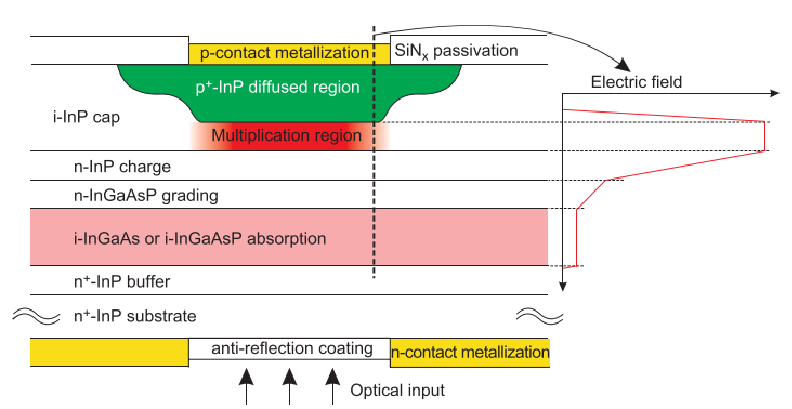
Argo SPAD sensor analysis
Photon absorption process
1. InGaAs/InP SPAD system
Photon absorption
Because of the high bandgap of InP (Eg = 1.35ev), the photons pass through the InP region.
Electron hole generation
The photons are absorbed at the InGaAs region (Eg = 0.75eV) and electron hole pairs are generated.
Hole propagation
The grading region prevents the hole from trapping at the interface between InGaAs region and InP region.
Absorption
InGaAs layer, Eg = 0.75eV, cutoff wavelength = 1670nm
InGaAsP
Grading
InP
InGaAs
InP
e⁻
InGaAs
e⁻
To avoid carrier accumulation in the heterojunction interface
Charge
h⁺
h⁺
To provide high electric field in the multiplication region
Impact ionization
Multiplication
The impact ionization is generated at the multiplication region.
To provide desired avalanche probability

Slide 3
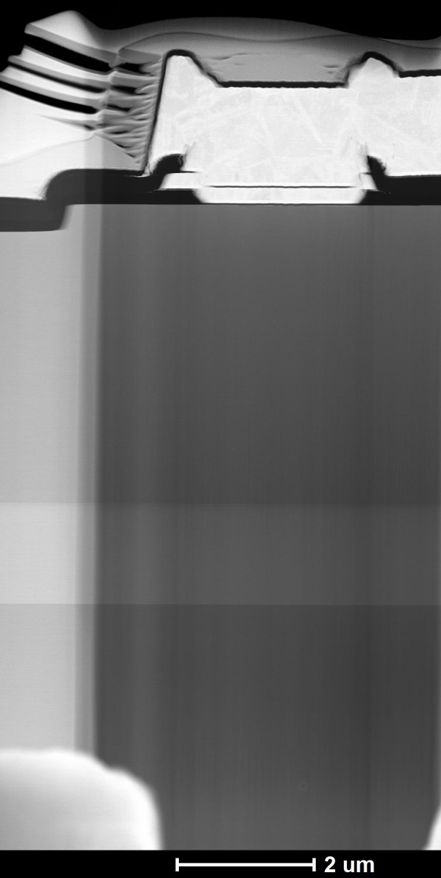
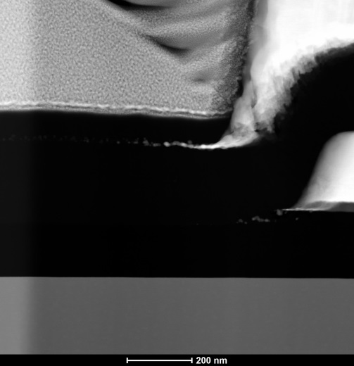
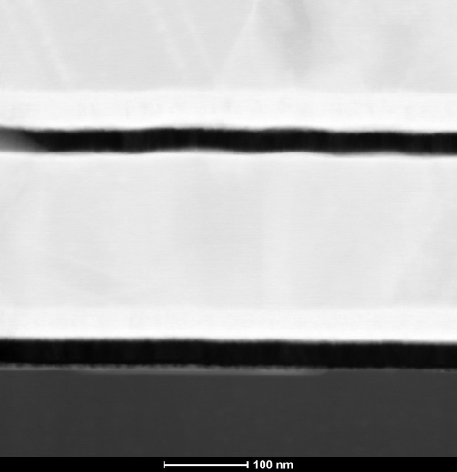
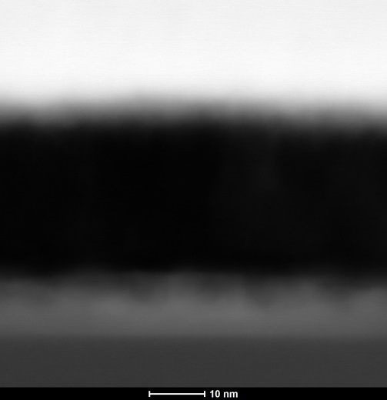
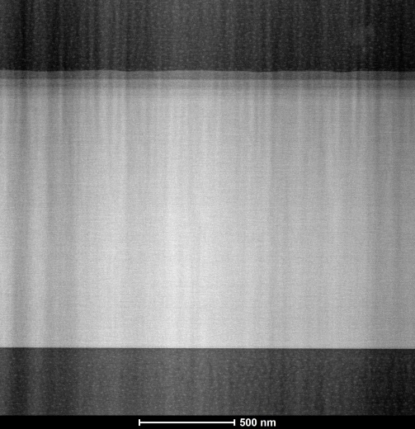
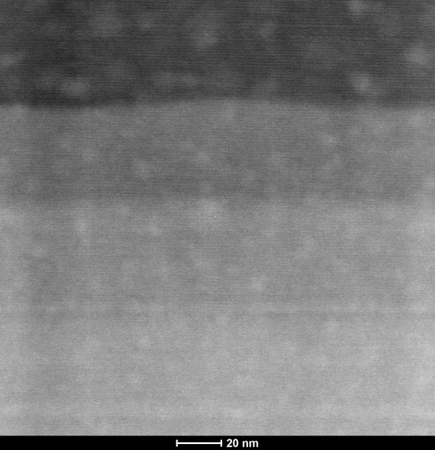

Argo SPAD sensor analysis
Overview
SiN_{x} : 91.5nm
1. Passivation
2. Anode Metal
3. Anode Contact
Au
Pt : 40nm
Au : 1.36µm
Pt : 44.2nm
1
SiN_{x} : 95.2nm
Ti : 29nm
2
SiN_{x} : 249.7nm
Au : 181.2nm
Ti : 27.3nm
Oxygen
@Interface
InP : 4.3µm
SiN_{x} : 161.4nm
Pt : 40nm
Ti : 28.4nm
Ti+InP(Diffused) : 27.3nm
3
4
4. i-InGaAs absorber
5. InP/InGaAsP Grading
6. i-InGaAs / InP Interface
Grading : ~136nm
5
i-InGaAs : 1.3µm
InP
Ga,As↑ / In,P↓
i-InGaAs
InGaAsP : 43.2nm
i-InGaAs : 1.3µm
InP
InGaAsP : 46.9nm
InGaAsP : 45.9nm
InP buffer
6
i-InGaAs

Slide 4
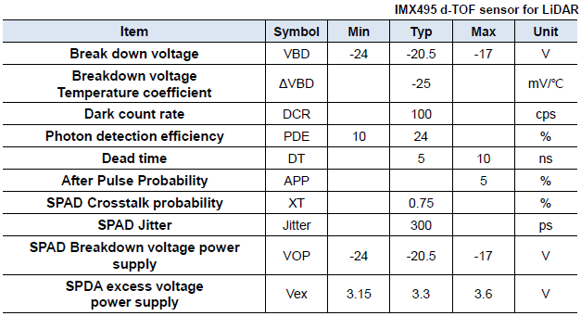
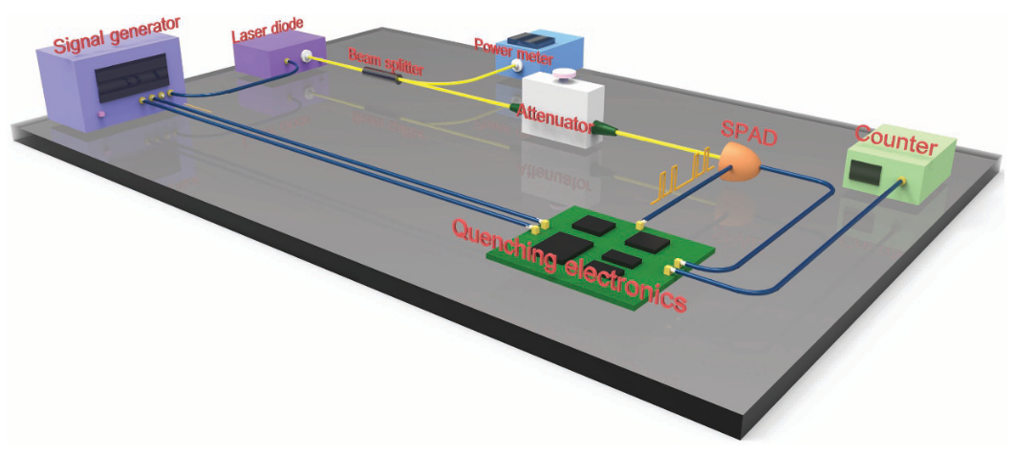
Argo SPAD sensor analysis
2. Characteristics of SPAD
Material characteristics
Breakdown voltage
Basic setup for characterize SPAD characteristics
Attenuator attenuating the laser power down to the single-photon level.
Quenching electronics gating the SPAD
Signal generator outputs original gates and synchronized signals with the same frequency to drive a laser diode
Counter counting the triggered signal
Quenching characteristics
Dead time
Efficiency characteristics
Photon detection efficiency
Done in RX test
Noise characteristics
Dark count rate
After pulse
Cross talk
Timing jitter
Advances in InGaAs/InP single-photon detector systems for quantum communication

Slide 5
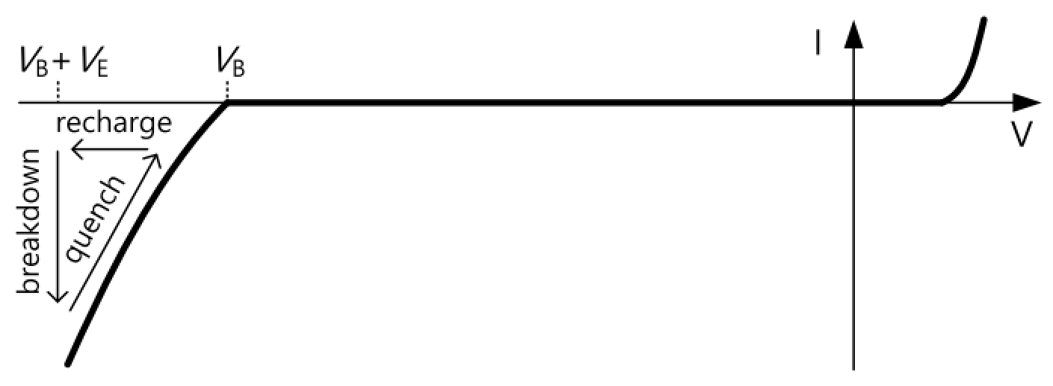
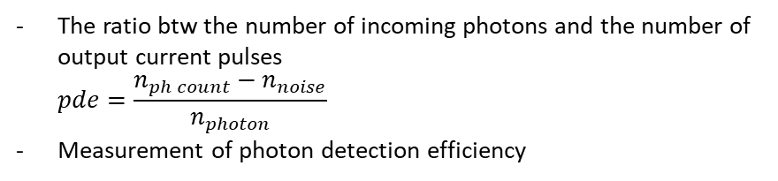
Argo SPAD sensor analysis
2. Characteristics of SPAD
Breakdown voltage
Dark count rate
Breakdown voltage
The thermally generated carriers can trigger the avalanche
Even when the device is kept in dark conditions, there can be avalanche process (dark count)
Measurement of dark count rate
The voltage at which SPAD fire
Protect the light propagating through the pixel
Operating region
Photon detection efficiency
Counting the avalanche event during the measurement time
The ratio btw the number of incoming photons and the number of output current pulses $pde=\frac{n_{ph count}−n_{noise}}{n_{photon}}$
Measurement of photon detection efficiency
Calculating PDE based on counted signals with in the time
Inspection criteria of Argo FPA module
Starting from single pixel illumination
Test | Description | Acceptance Criteria
Array turn on voltage (V₅₀) | Find voltage at which 50% of pixels fire | 85V ± 10V
VBR gradient | Find difference between voltage at which 85% and 15% of pixels fire at all | ≤1V
V_{PDE20} | Find voltage where average PDE of array is 20% | V_{PDE20} exists and V_{PDE20} ≤ V₅₀+4.2
DCR(V_{PDE20}) | Find exp[mean(ln)] DCR for array at V_{PDE20} | exp[mean(ln)] DCR for array at V_{PDE20} ≤ 500kHz
The target pixel starts avalanche event
Counting the avalanche event during the measurement time.
Calculating PDE based on counted photons and incoming photons

Slide 6
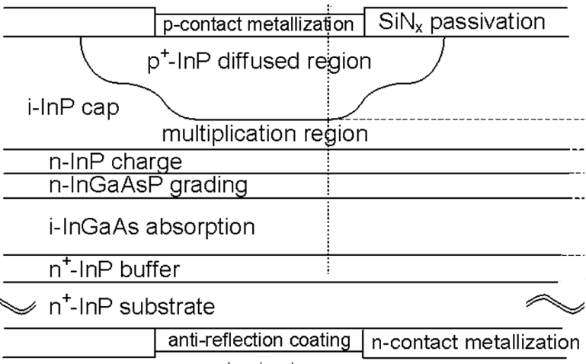
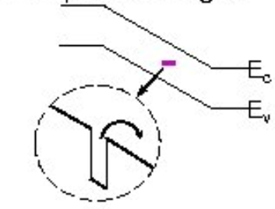
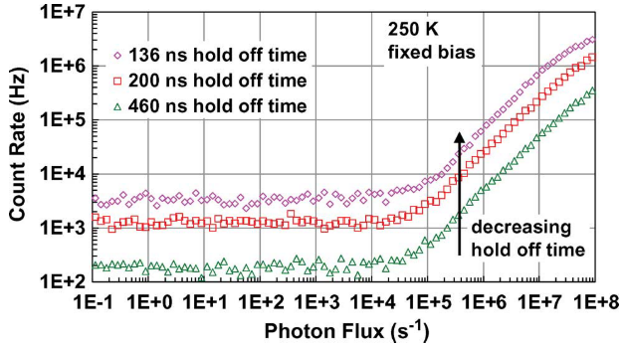
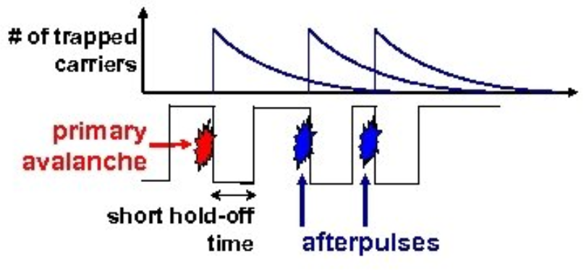
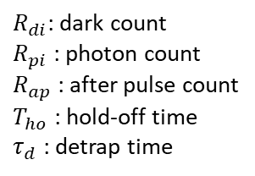
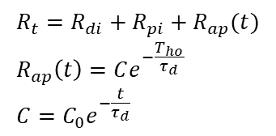
Argo SPAD sensor analysis
2. Characteristics of SPAD
Measurement of after pulse
After pulse
Measure the dark count rate for specific dead time
The probability to have another count in the same pixel, that is correlated to the former one
Due to the trapping of free carriers during the avalanche
Larger the SPAD hold off time is, the smaller the after pulse probability is
Repeat the dark count measurements with different dead times set for the active quenching circuit
SPAD gating speed
Trade off
After pulse
Measure the photon count rate for same dead times
Dead time ↓
Dead time↑
Trapping site
Using the below equation, calculate detrap time and average after pulse
$$R_{t}=R_{di}+R_{pi}+R_{ap}(t) \\ R_{ap}\left(t\right)=Ce^{−\frac{T_{ho}}{τ_{d}}} \\ C=C_{0}e^{−\frac{t}{τ_{d}}}$$
↓ Count rate per photon flux
$R_{di}$: dark count $R_{pi}$ : photon count $R_{ap}$ : after pulse count $T_{ho}$ : hold-off time $τ_{d}$ : detrap time
Afterpulsing Effects in Free-Running InGaAsP Single-Photon Avalanche Diodes

Slide 7
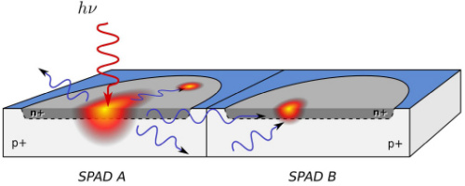
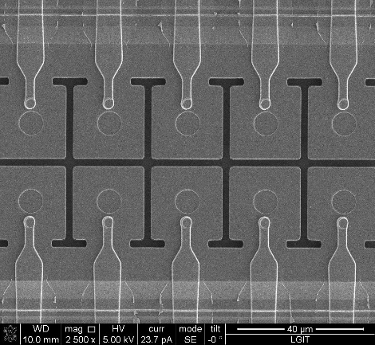
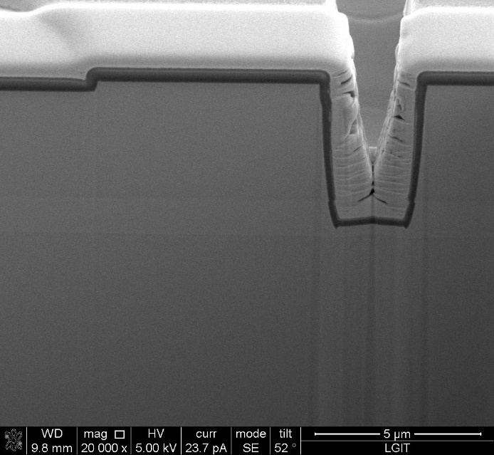
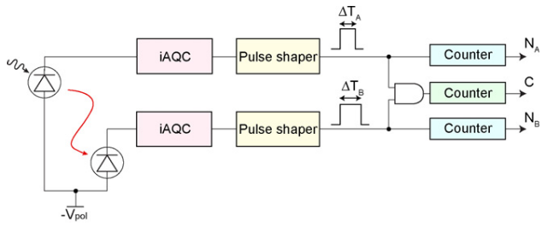
Argo SPAD sensor analysis
2. Characteristics of SPAD
Measurement of crosstalk
Crosstalk
Starting from single pixel illumination
The hot carriers lead to intense emission of secondary photons
Some of which escape from the chip
If re-absorption takes place within the active area of a neighboring pixel, an avalanche process is triggered.
The target pixel starts avalanche event
Scanning the data for a trigger pixel that experienced an avalanche event
Search for all pixels that may have fired at nearly the same time as the trigger pixel
Analyze the temporal correlation of assumed crosstalk counts with test trigger pixel
Can be prevented using isolation between pixel
Assumption: Any avalanche event within some ns of the trigger pixel is correlated
1
5.68µm
1
InP-based Geiger-mode avalanche photodiode arrays for three-dimensional imaging at 1.06um

Slide 8
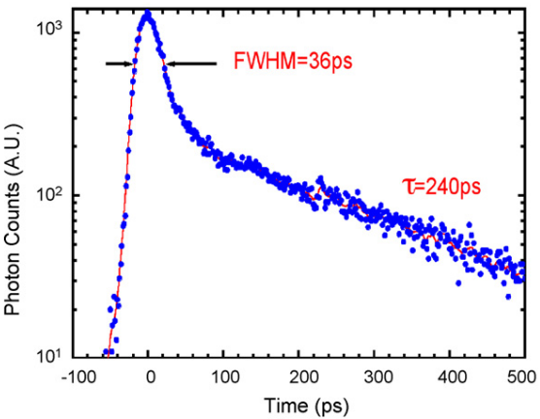
Argo SPAD sensor analysis
2. Characteristics of SPAD
Timing jitter
The total time uncertainty between incident photons and corresponding electrical signal outputs
Measurement of timing jitter
Sending laser pulses directly to the detector
Collecting the histogram of the distribution of the delay
Jitter

